Slide 1
“SORTING ALGORITHM VISUALIZER”
“Web Portal For Neural Style Transfer"
NATIONAL INSTITUTE OF TECHNOLOGY KARNATAKA
SURATHKAL
By-
SUDIKSHA AGRAWAL
194CA046
MACS Department
NITK, Surathkal

Slide 2
INTRODUCTION
This is a Chainer implementation of techniques like Image Style Transfer Using Chainer – a python-based framework for neural networks, Preserving Colour in Neural Artistic Style Transfer. Additionally, techniques are presented for semantic segmentation and multiple style transfer. The Chainer algorithm synthesizes artistic image by combining content images with style models.
This project aims at transferring the style from one model onto another image, goal is to synthesise a texture from a source model while constraining the texture synthesis in order to preserve the semantic content of a target image. The style model and the target image can be uploaded by the user from the user interface, the user can also click her/his own picture through a webcam to generate his own target image. The synthesised image is saved in the local system of the user and is displayed onto the user interface for inspection.

Slide 3


The objective of Web Based Image Style Transfer Using Chainer Neural Network framework is to implement algorithms that take as input a content image and a content style — and outputs a new image depicting the objects of the content image in the style model. This technique is quite a hot topic and is widely used nowadays to create different "image filters" or "selfie filters" which are popular in social media platforms like Instagram and Snapchat
PROPOSED SYSTEM

Slide 4

Software used - python: 2.7.12 or later chainer (A Powerful, Flexible, and Intuitive Framework for Neural Networks) opencv: 2.4.9.1 VGG16 model NumPy 1.9, 1.10, 1.11, 1.12 Django web framework HTML, CSS, Bootstrap for front end Implementation - HTML, CSS, javascript and bootstrap are used for front end and styling Chainer is used for implementing neural networks opencv is used to capture image dynamically Django is a server side web framework which is used to handle HTTP requests, database control and management, URL mapping, etc.
DESIGN AND IMPLEMENTATION

Slide 5
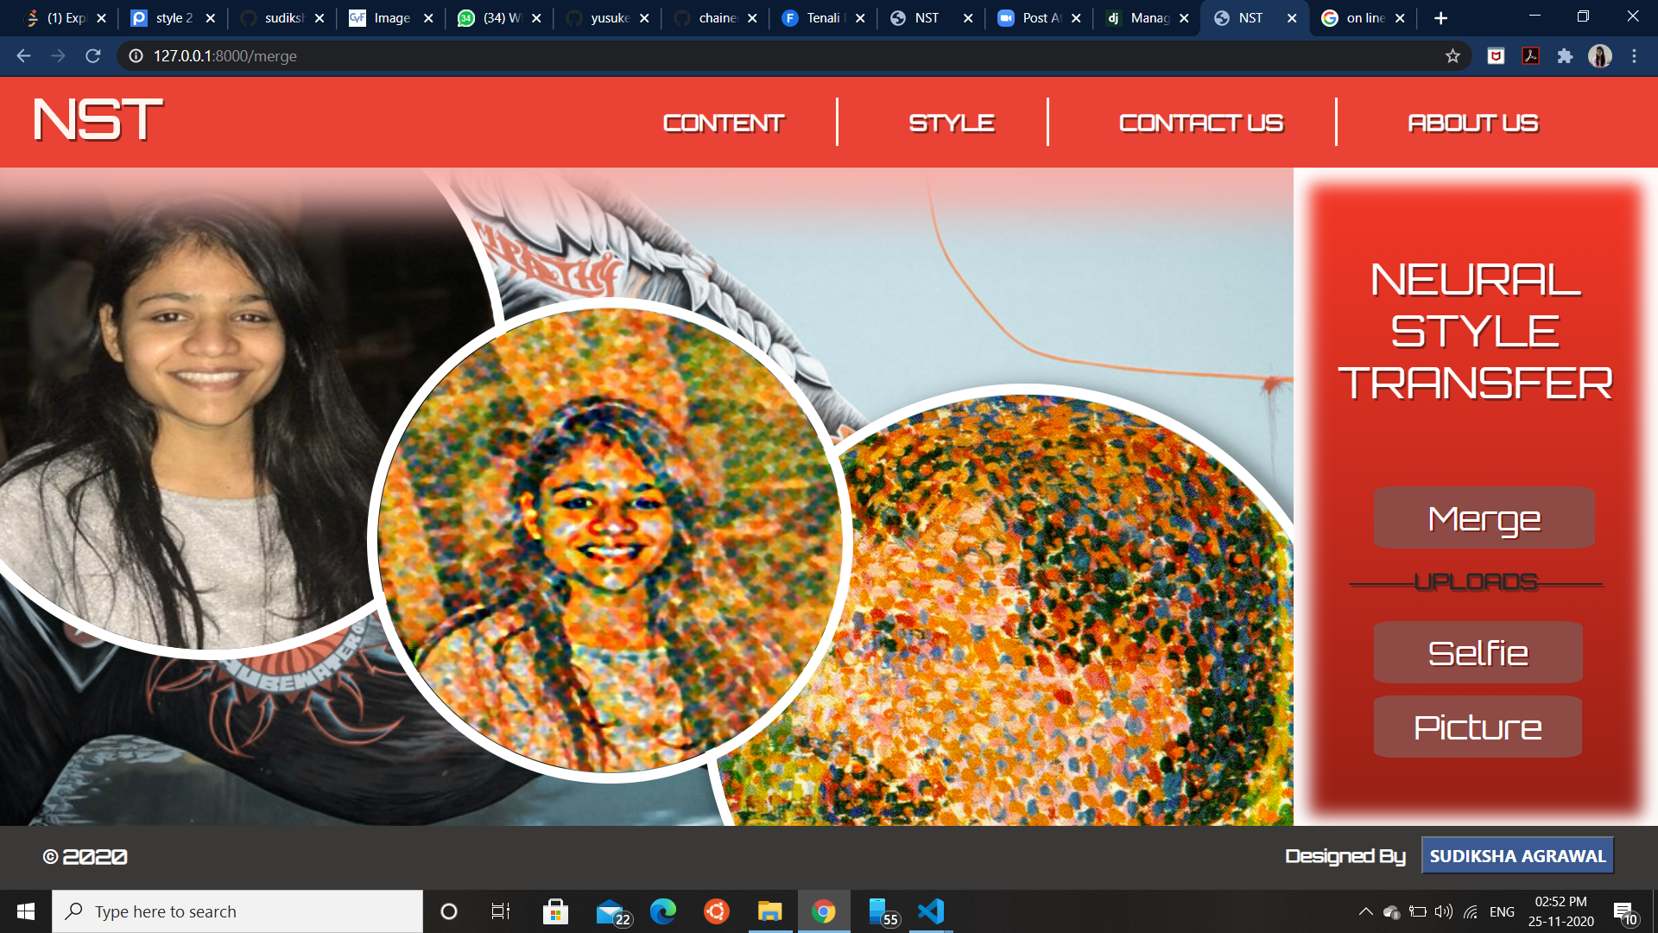
This page is index.html. It handles all the functionality of this project.

Slide 6
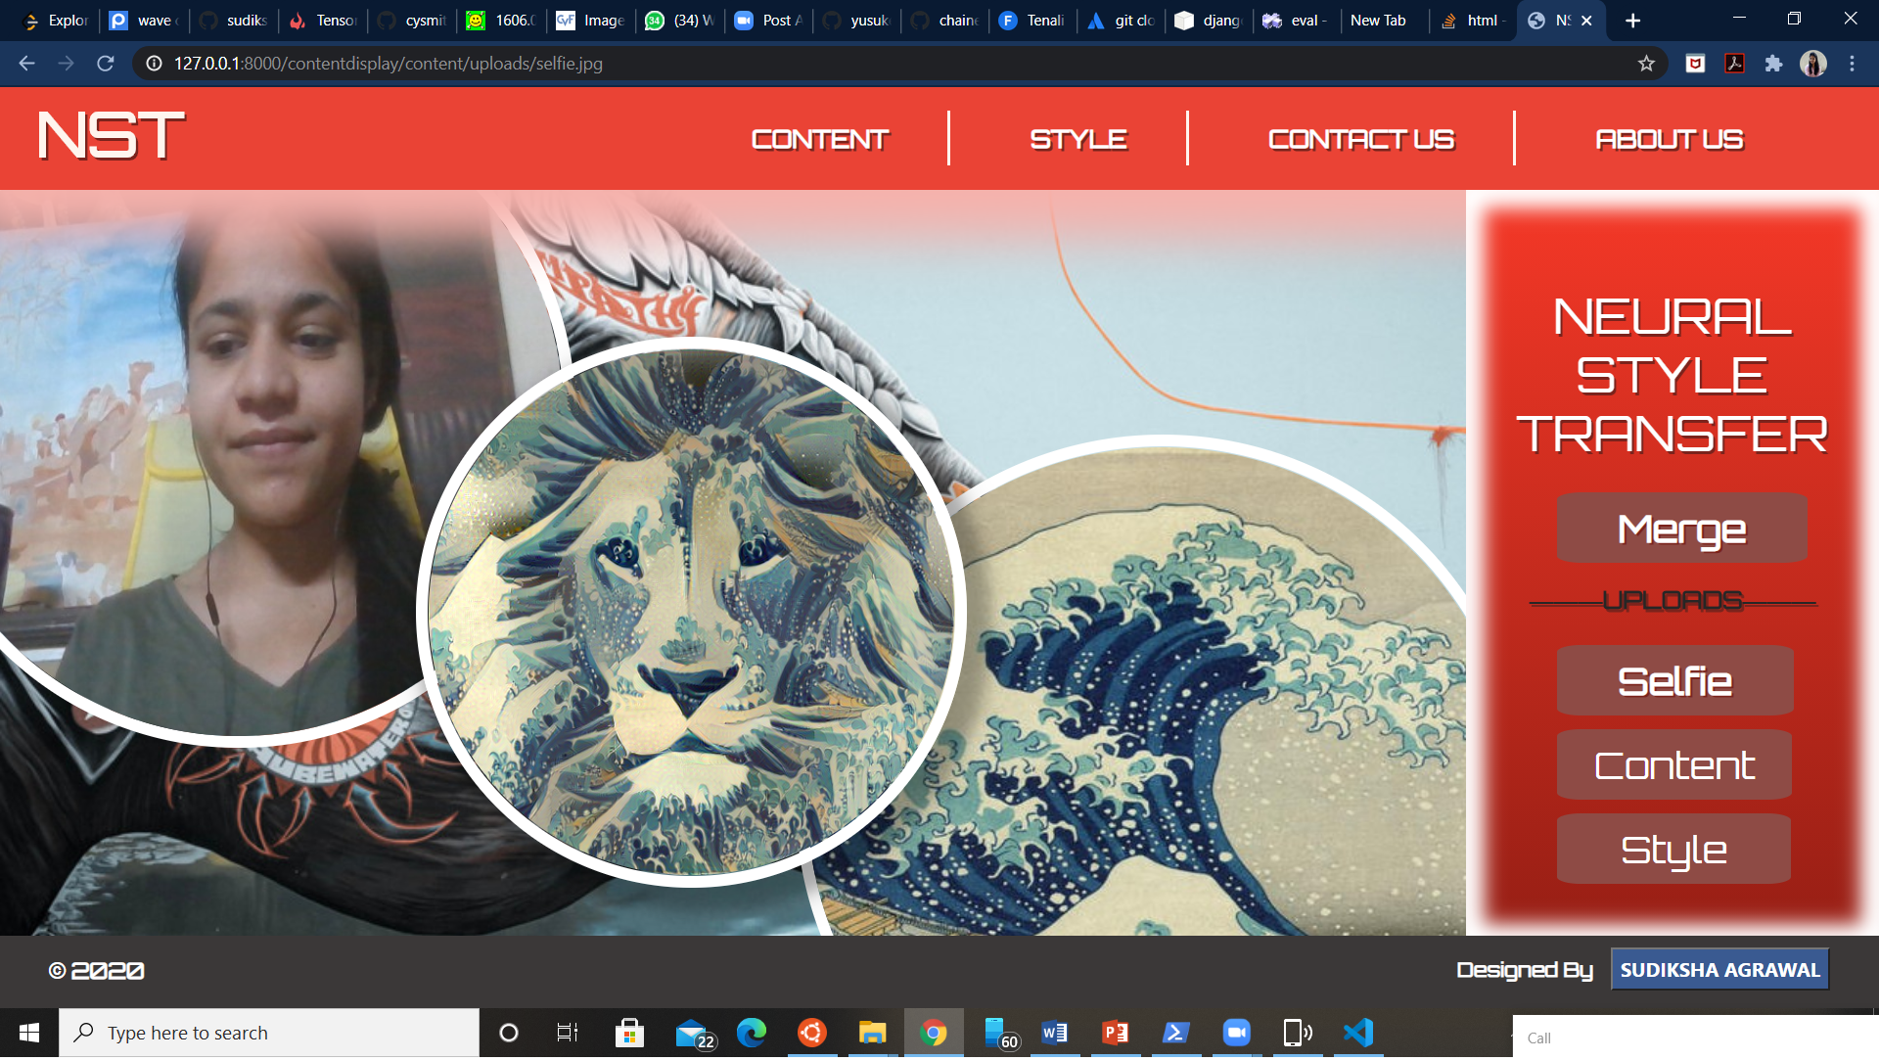
After clicking on selfie button your picture is clicked from python’s opencv module and saved on your system dynamically, it is also saved in database.

Slide 7
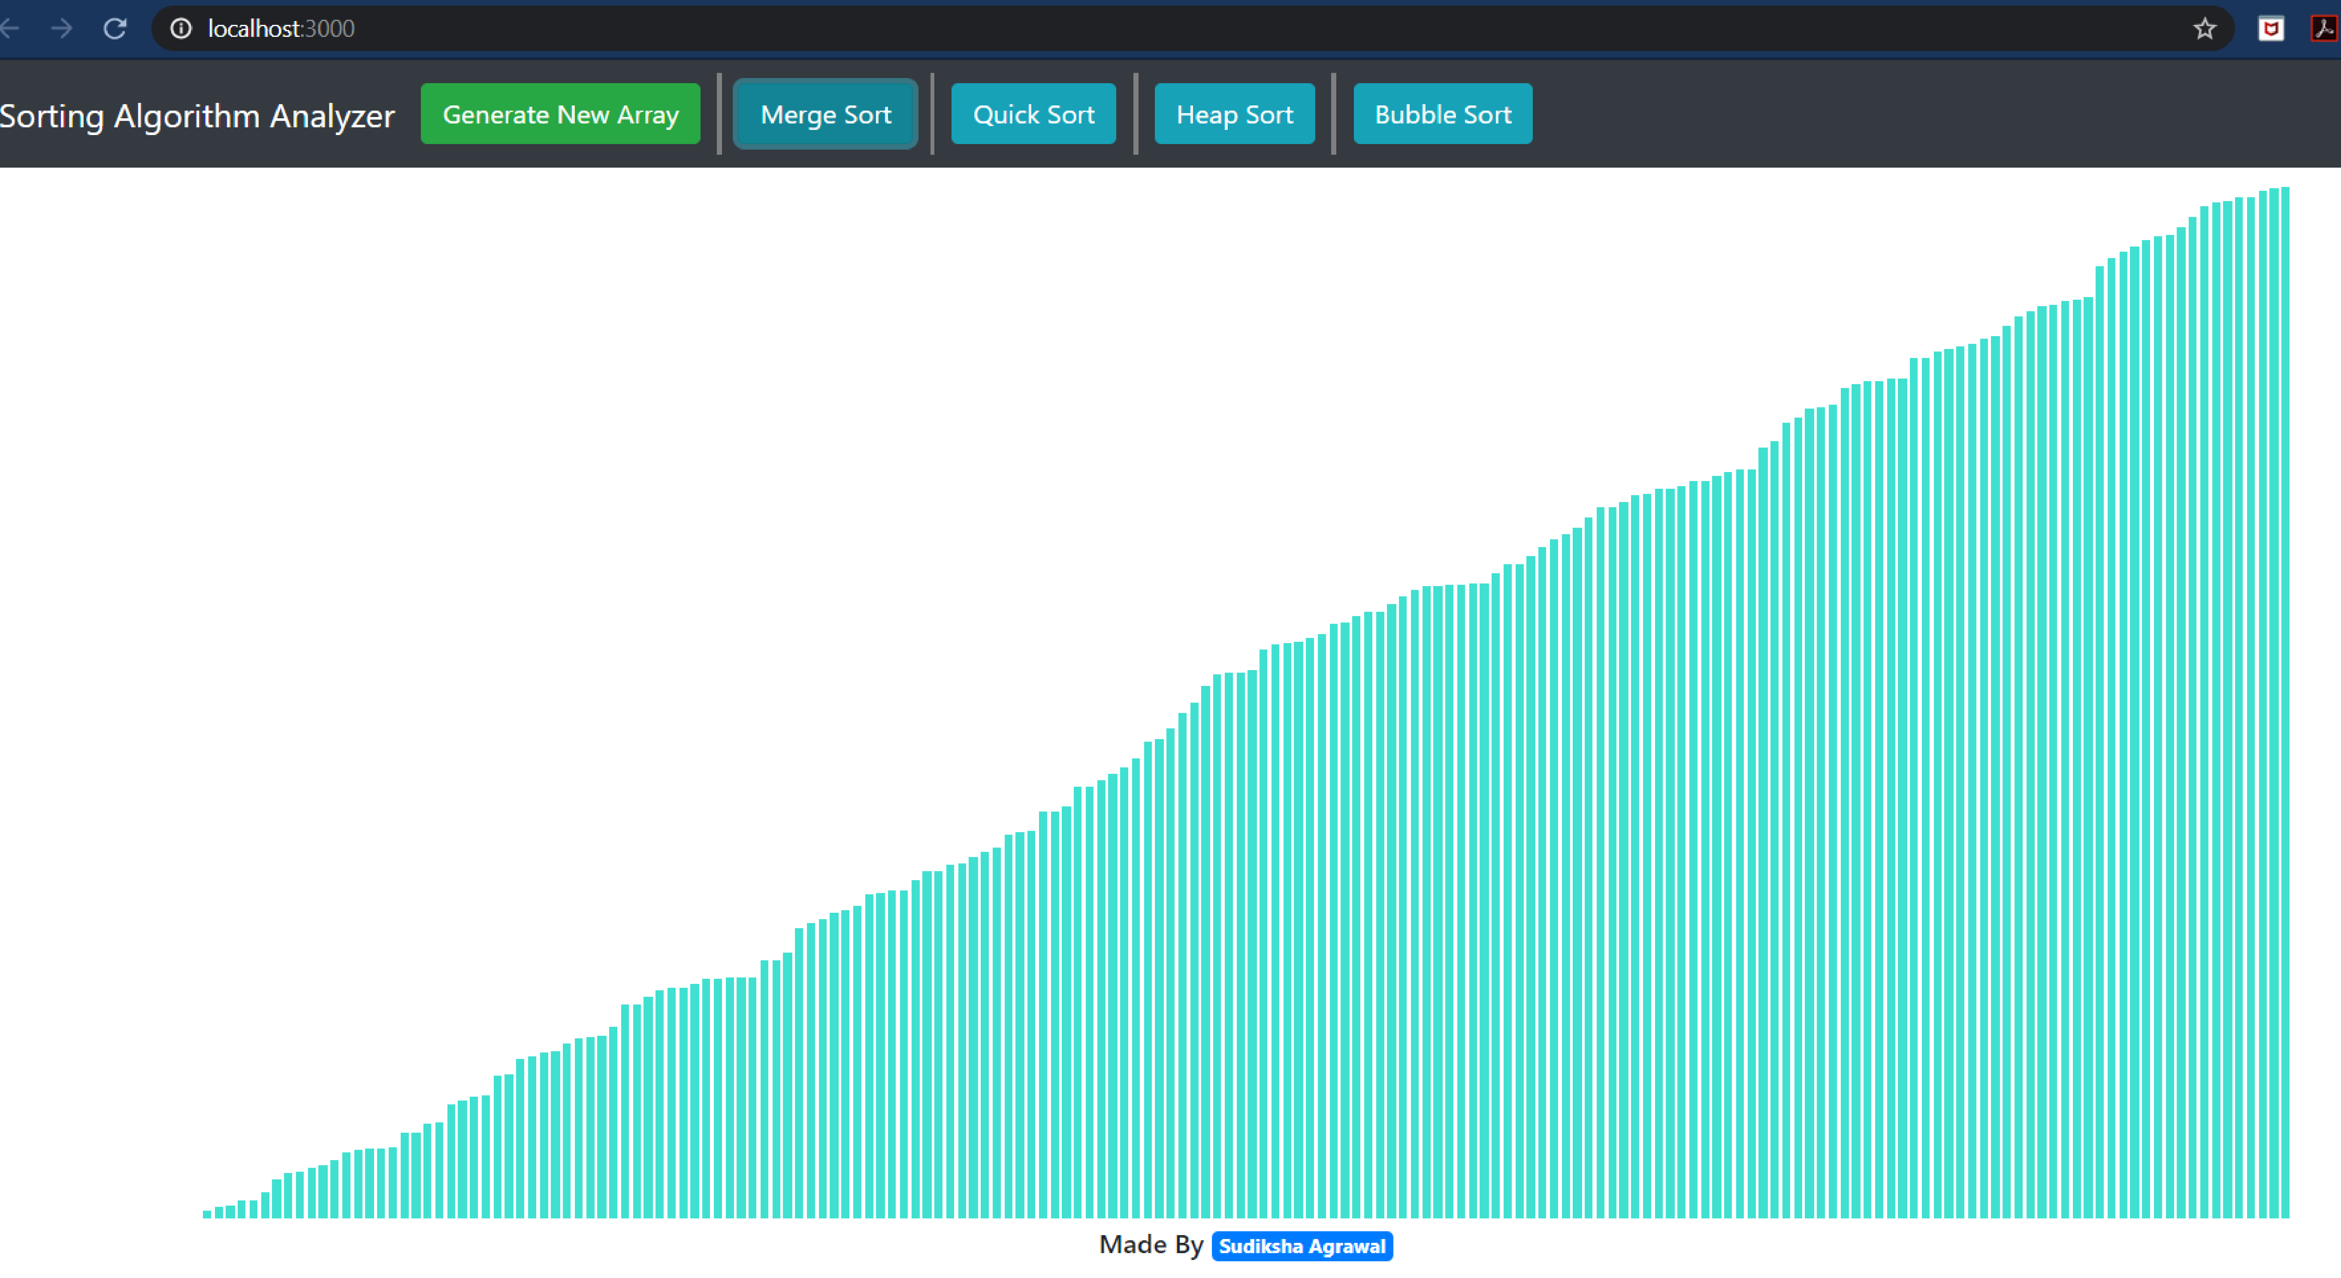
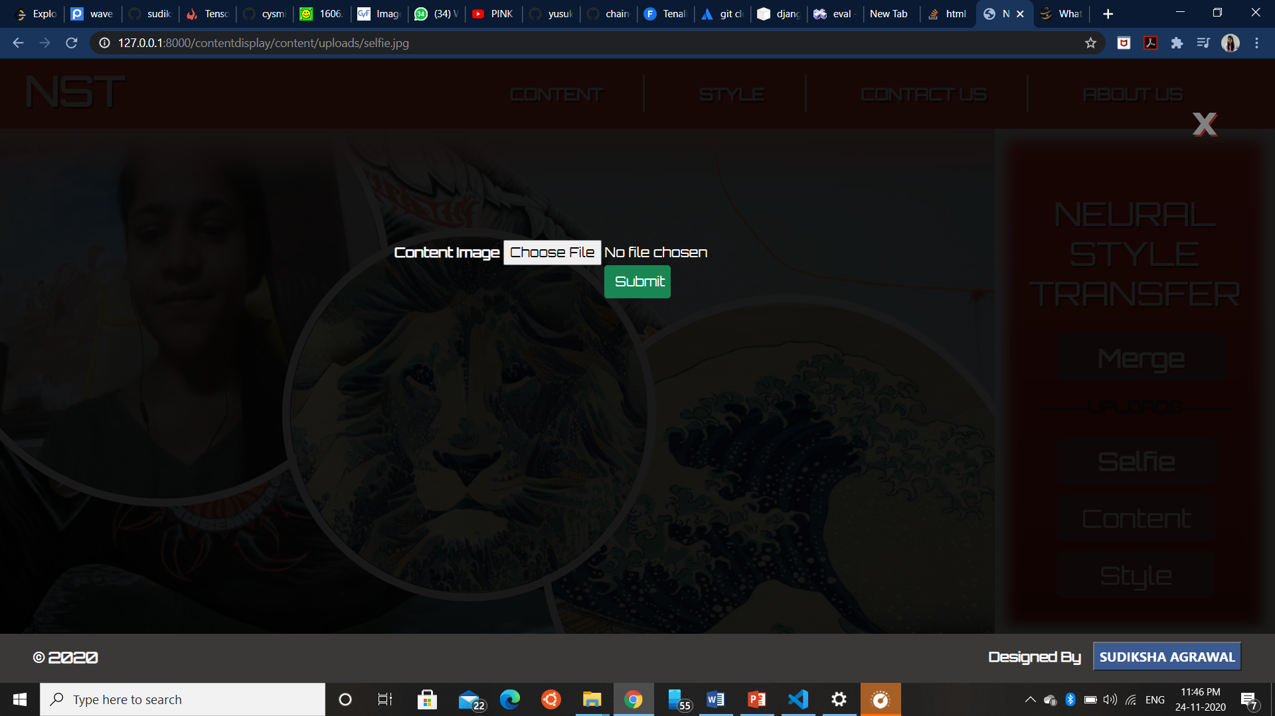
This is the result of project. Every algorithm will give the same result, but by visual representation of the sorting process we can have a better understanding of working algorithm, i.e., how the elements are swapped and compared. And the time needed by each algorithm to sort a large array.
By clicking on content button on right container this overlay window is opened and you can upload any image from your local system, this image is then saved in uploads folder on your local system as well as in database. This image can be then used as content image.

Slide 8
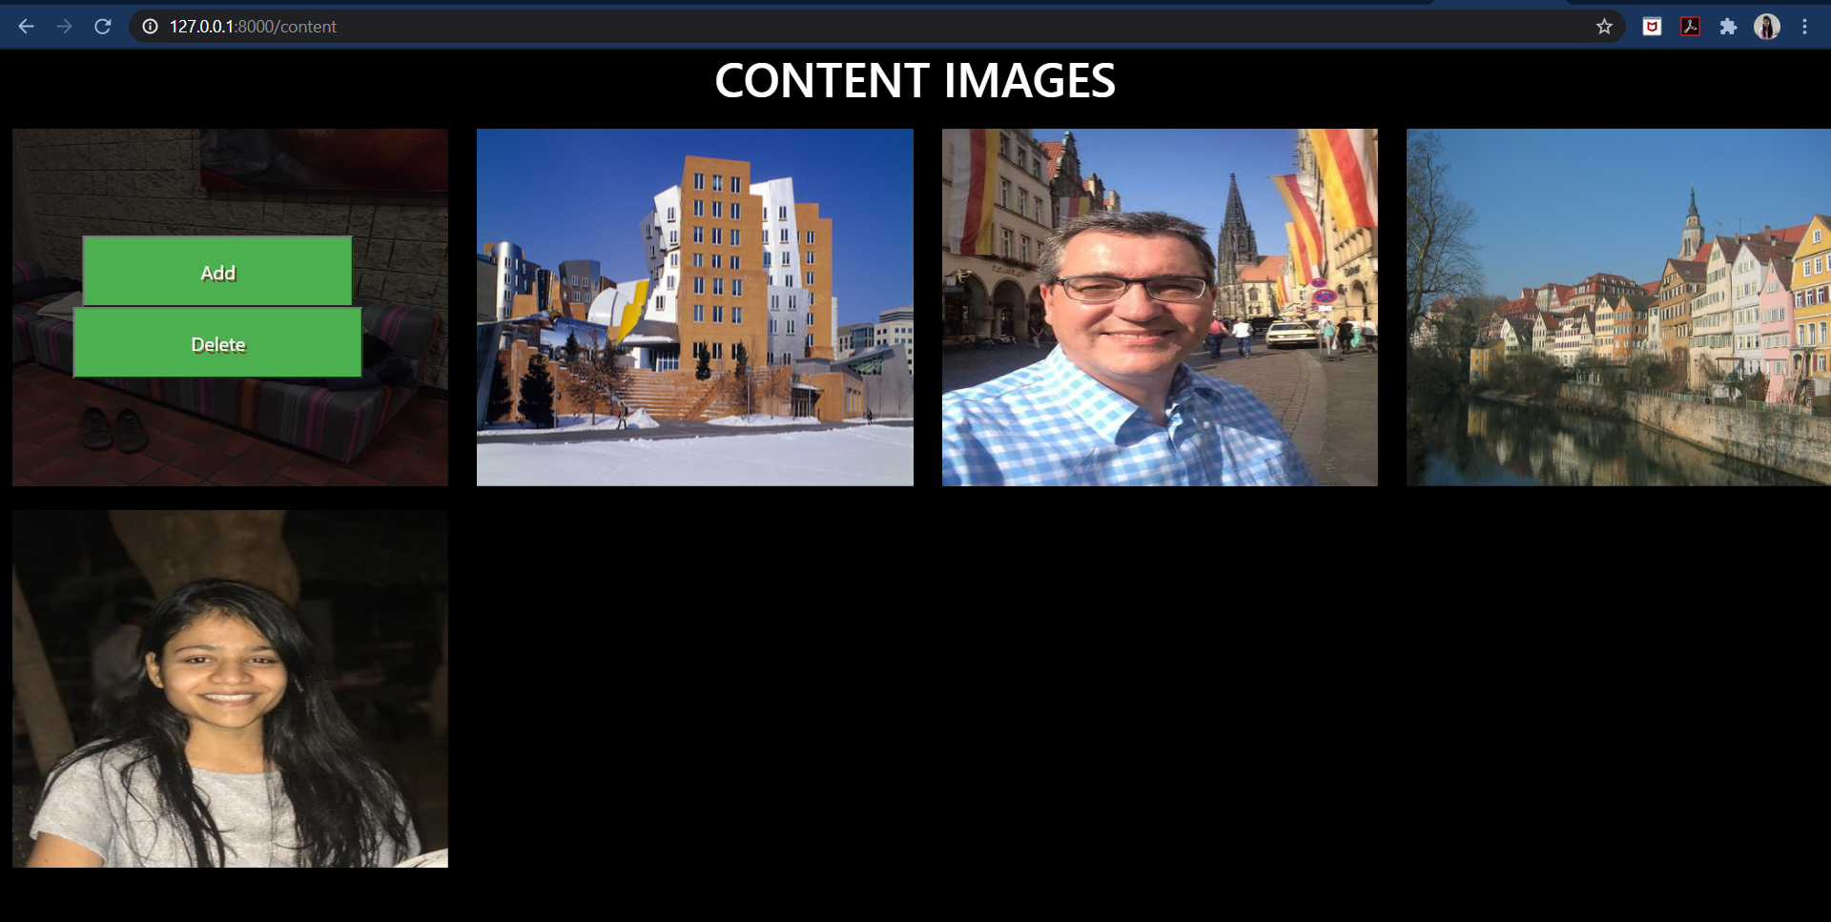
This is the content page where all the content images which you have uploaded from your local system or clicked from webcam are displayed for preview. This page provides one more functionality that you can add any image as content image for neural processing, user can also delete any content image.

Slide 9
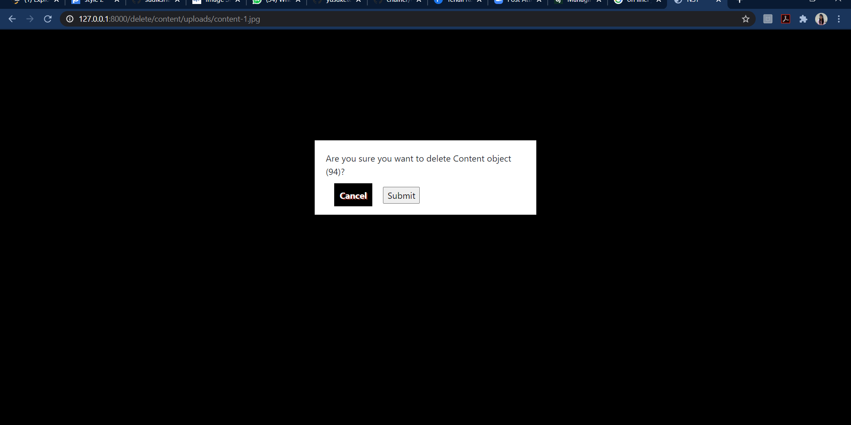
Delete page

Slide 10
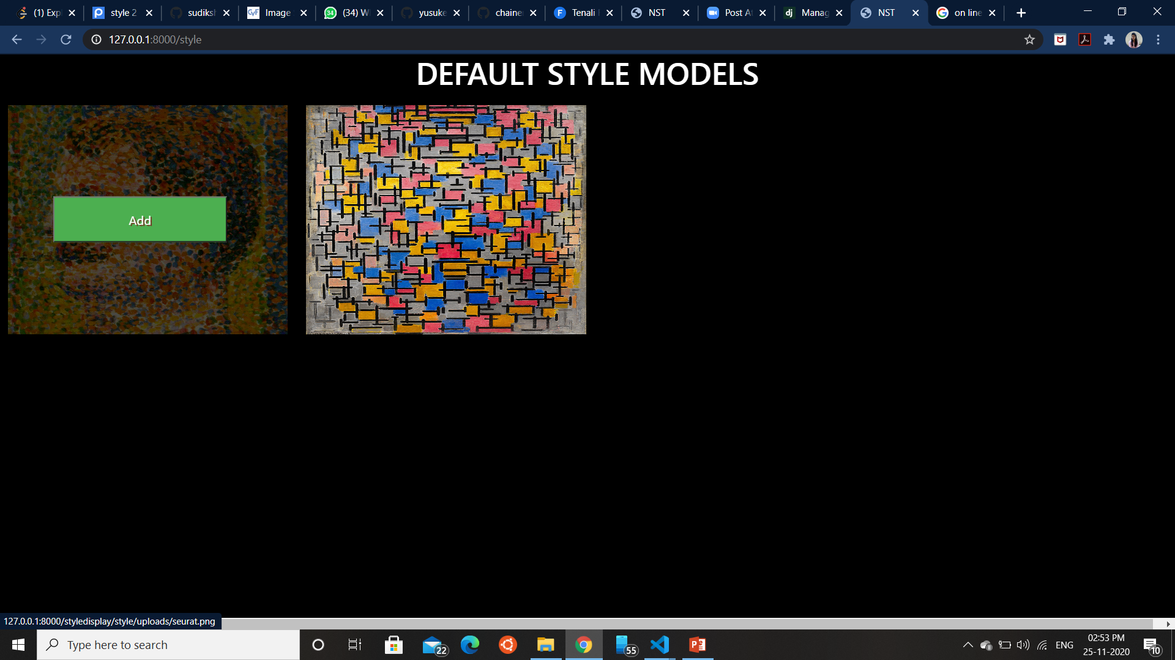
After seeing the visualization of variou sorting algorithms we can easily understanding the working of these algorithms.
Future Aspects
We can a functionality on UI from which we can dynamically change the size of array.
We can make similar visuals for various other algorithms like the shortest path and various DP algorithms for better understanding.
This is the style page where the style images given the preview of both the models are displayed, you can choose any style to add to you content image. This page provides one more functionality that you can add any image as content image for neural processing.

Slide 11
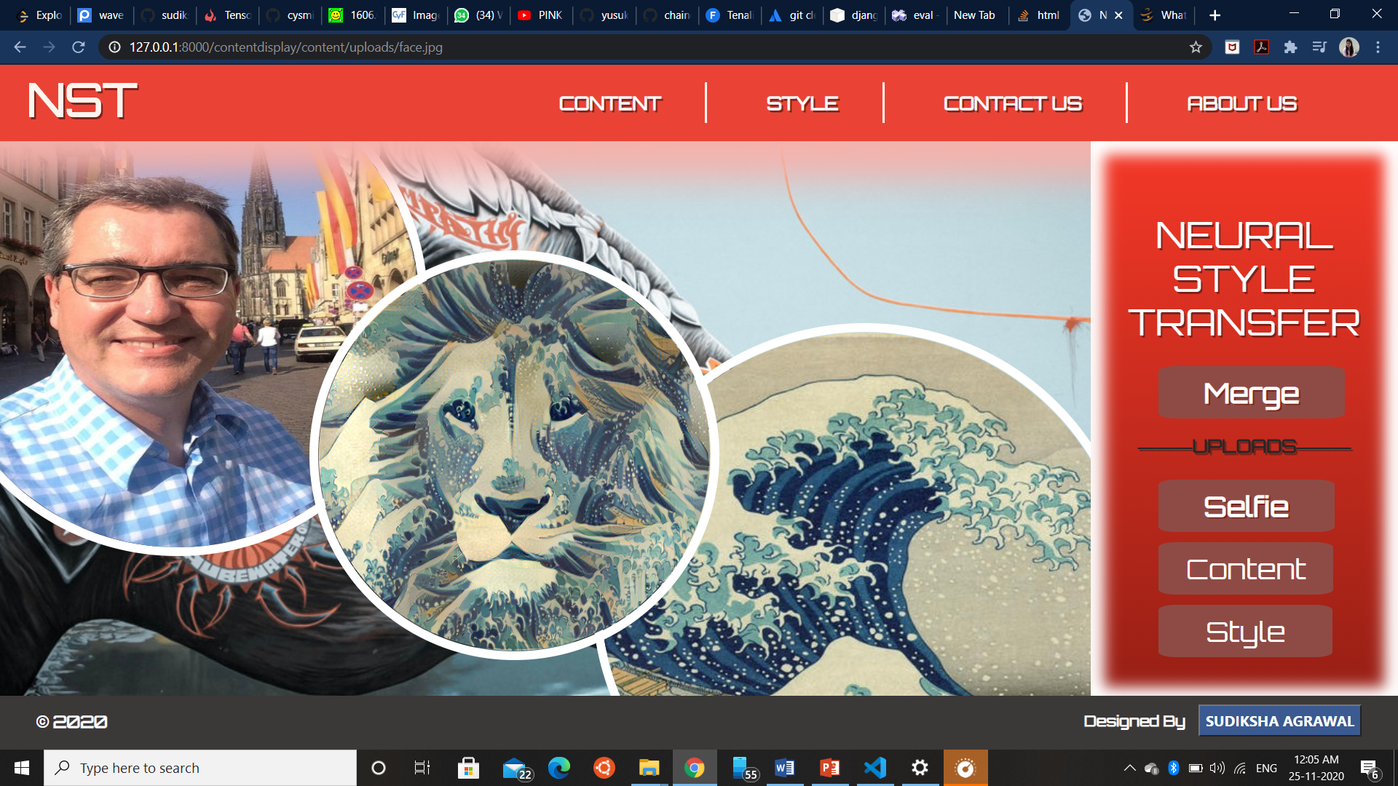
Chosen style image is displayed in the left circle and chosen content image is displayed in the right circle and the result generated is displayed in the middle circle.

Slide 12
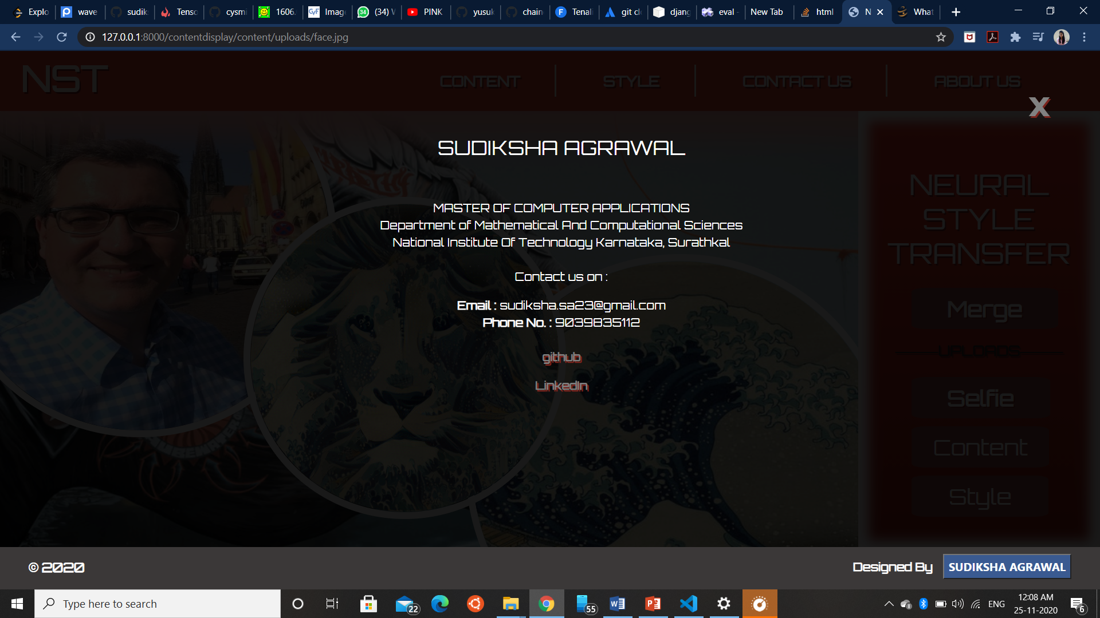
This is the contact us overlay, which displays all of my contact information.

Slide 13
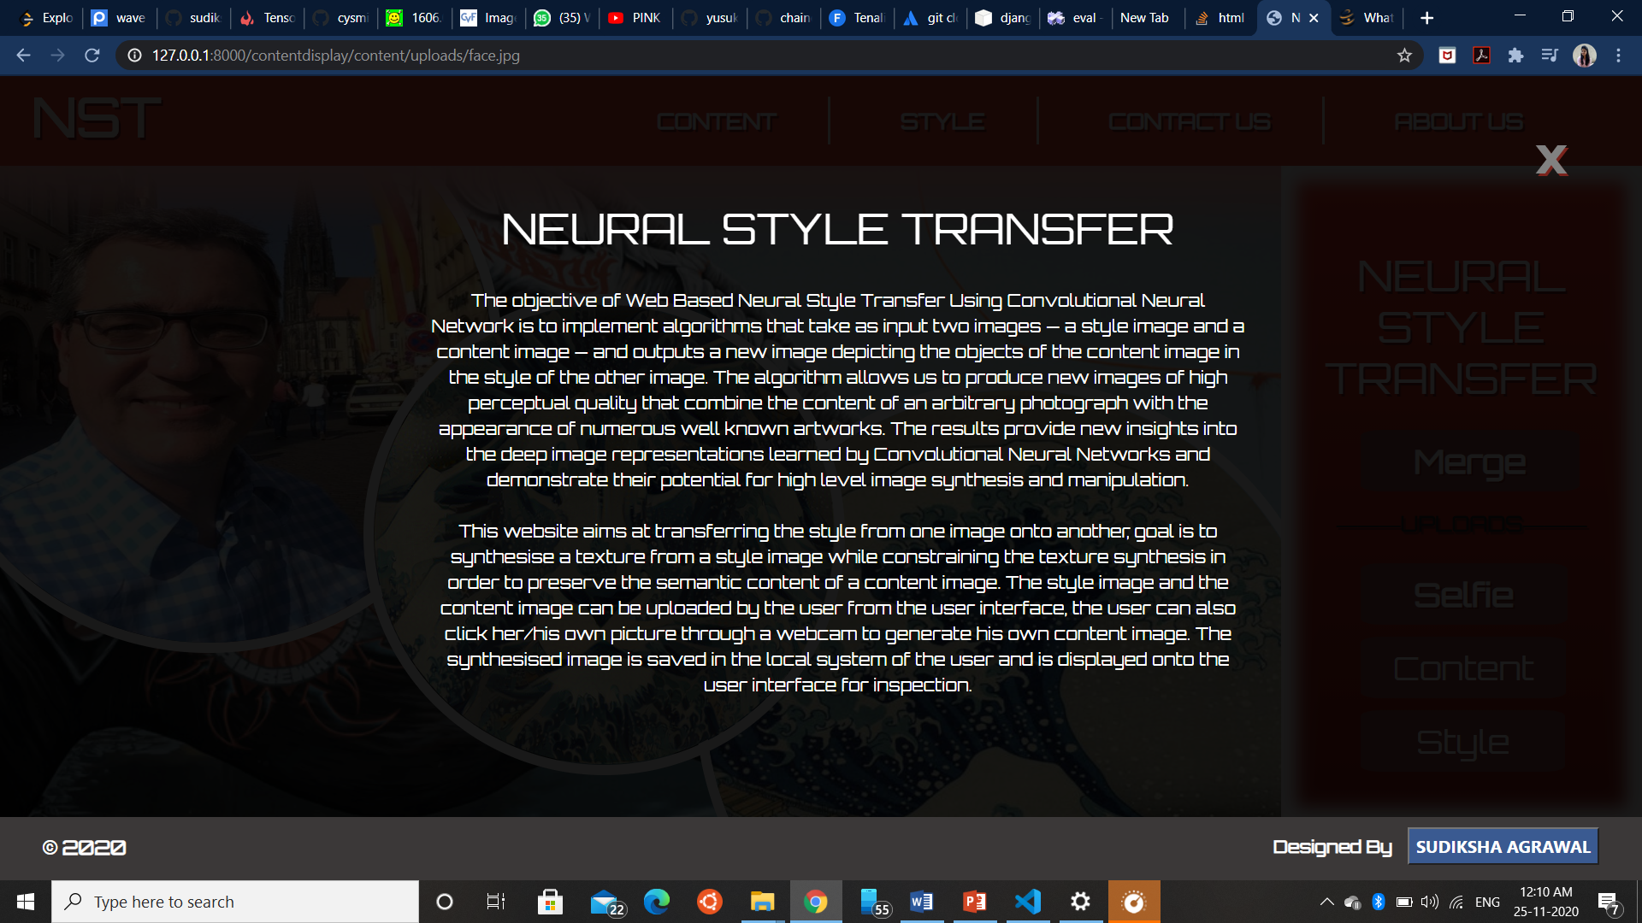
This is the about us page which displays information about technologies used in this website and the functionality rendered by this.

Slide 14
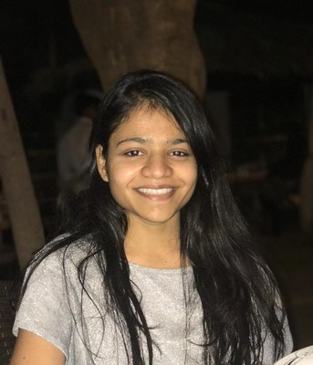
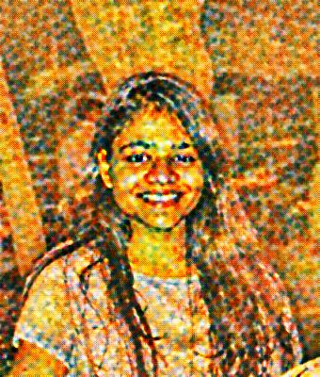
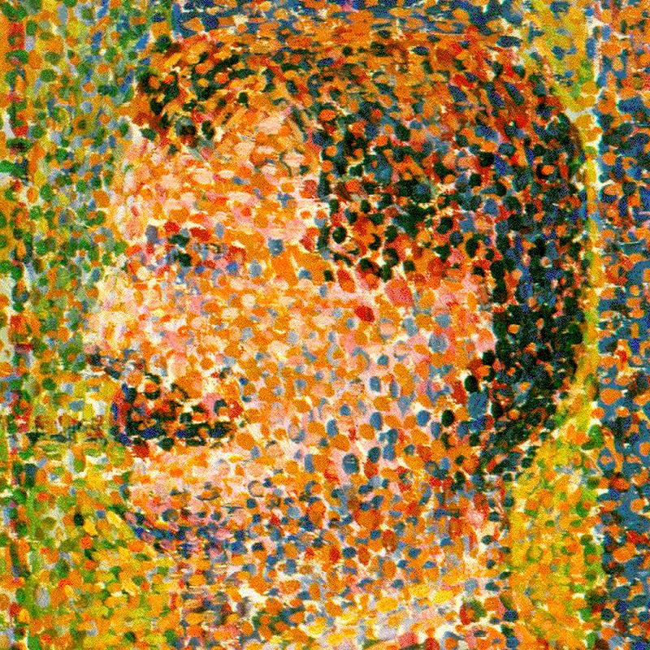
Result ANALYSIS
Seurat model used for styling

Slide 15
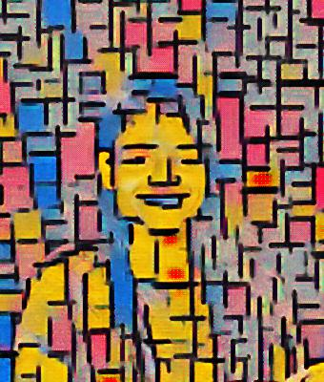
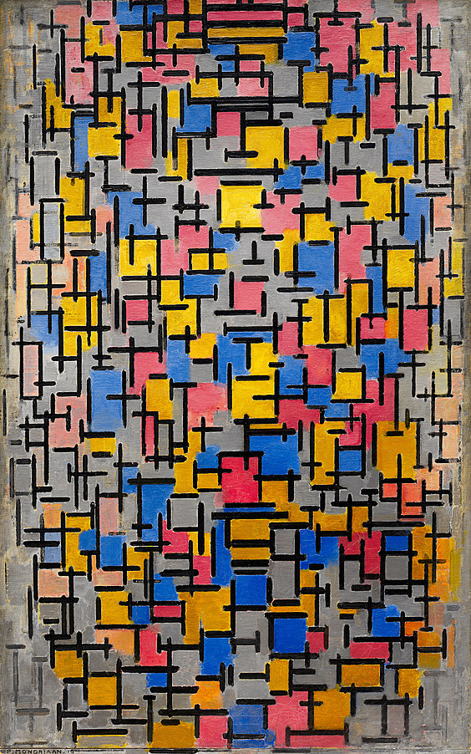
Result ANALYSIS
Seurat model used for styling

Slide 16

This project is a successful implementation of fast neural style transfer using chainer framework. This implementation is made user friendly by making a web portal where users can implement chainer style models on his own picture or any picture.
Conclusion

Slide 17


